Slide 1

GitHub Copilot
Start a Project using plan mode

Slide 2
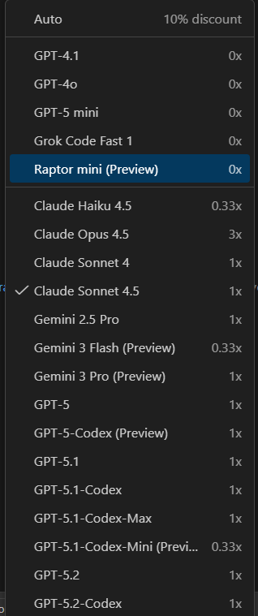
Selecting Ai model
While using GitHub Copilot there are 2 types of LLM (Large Language Models) are available.
Free tier Models
Paid tier Models
Free models are unlimited but might be slower
Paid models are faster and accurate but will be charged at different request rates.

Slide 3
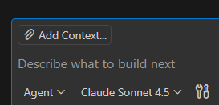
Adding context
You can provide context to GitHub Copilot in several ways to get more relevant responses, including explicitly mentioning files, using slash commands, highlighting code, and using configuration files. The primary methods vary slightly between inline code suggestions and the Copilot Chat interface.
Mention files, folders, or symbols
Highlight relevant code
Use chat variables and agents
  ( #selection , #file, @workspace or #codebase #fetch [URL])
Slash commands
Drag and Drop
Use the Add Context button

Slide 4
Static project
Inside the chat window keep the mode as plan and then let’s start explaining what we are planning.
Make sure that there is no context is added.
Below prompt to be added to chat window:
“ This is a static html project called Capture Data – HTML. We need a UI Library for styling and we need income and Expenses inputs for months Jan-Dec. The UI should be split into 2 tabs ("Data", "Chart"). The chart tab plots a bar chart of the income and expenses from the inputs in the data tab. We will need a suitable chart Library to render this chart”
Note : Make sure you are typing this code in chat window, instead of copy pasting , as while copy pasting , it will capture it as a screen shot

Slide 5
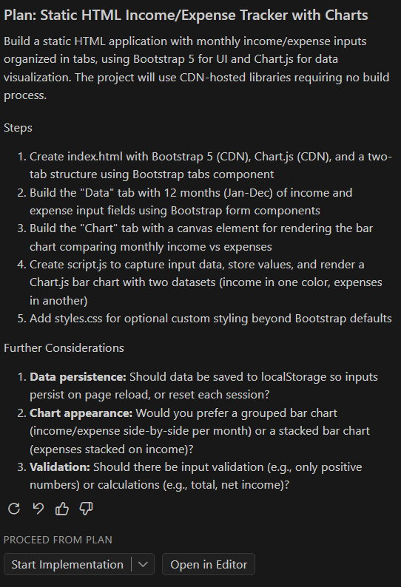
Plan
Before giving answer , it might ask you to enable the model you are using for getting replies.
Copilot has understood the requirement and spitting the plan document .
Developer must read the document and understand whether the plan process is based on his/her thought process, else need to tweak the prompt again.
If the outcome is meeting requirement , you need to provide answers to the questions asked by chat (Plan) Agent
Note : Make sure you are typing this code in chat window, instead of copy pasting , as while copy pasting , it will capture it as a screen shot

Slide 6
ANSWERS
Below will be the chat answer:
To answer your questions
1 . We do not need any persistence
2. It is better to show grouped bar chart
3. Only Positive Numbers
There will be a possibility that you might get different questions as this will not be same for all.
Note : There could be more questions and you need to answer before implementing the Project Plan

Slide 7

Start implementation
Once all the questions are answered, we can implement the project plan. Click on Start implementation.
You will notice the plan mode now changed to Agent mode and click on Play button

Slide 8
Implement download feature
Within index.html keep the curser at a location where you want a download button, and type html comment .
<!--Download Button-->
Which will be considered as Inline Suggestion and download button will be created.
Also using Agent chat mode , we can create buttons as required

Slide 9
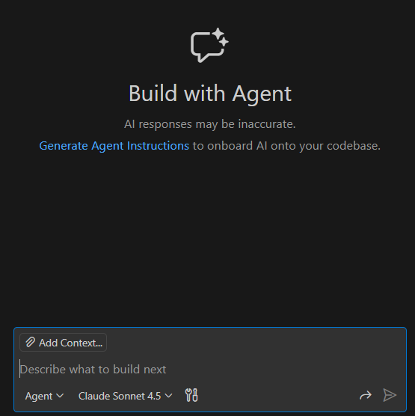
GitHub copilot agent instructions
Open a new chat window and click on Generate Agent Instructions
Look at the prefilled area will have certain guidelines and also explains what is going to be generated
Once you click on the link, it generates copilot-instructions.md a markdown file which contains complete information about project , coding standards and architectural standards to implement the project plan.
This file name will be either as copilot-instructions.md or AGENTS.md
In the next project we work with AGENTS.md and we see why it is important and useful.
AGENTS.md is universally accepted among various AI Tools, so in case you have shifted from GitHub copilot to another AI tool , still AGENTS.md will be relevant
Notes:
Current project might not require this file but going forward when the project is getting bigger we might require to have this in place to understand the summary and what is happening in the project. This name should not change to any other name. It should be either copilot-instructions.md or AGENTS.md. To know agents.md applicability you can just search agents.md in google to get idea which all tools support this markdown file.

Slide 10
Some thing interesting in copilot-instructions.md
In copilot-instructions.md file, under ##key conventions
Add a section ### UI Element
Under that , add the text “All buttons should be in pink colour”
Go to the chat window , open a new chat window and add this chat instruction to the agent
“Above the data and chart Tabs, in index.html render a username input which must contain at least 1 uppercase , 1 number, 1 special character and must be at least 5 char long.
Underneath this input render a submit button. That will give us idea how that markdown file is important.
Also understand how to do refactor using slash command
🥏 Important
Any new Activity in Agent Chat , always
open a new chat window and then start
conversation for a better context and clean context
Notes:
Current project might not require this file but going forward when the project is getting bigger we might require to have this in place to understand the summary and what is happening in the project. This name should not change to any other name. It should be either copilot-instructions.md or AGENTS.md. To know agents.md applicability you can just search agents.md in google to get idea which all tools support this markdown file.

Slide 11
Edit mode and refactor specific code
Select the code generated in index.html and jump into edit mode and type the chat as refactor this code and render that in a form tag. Which makes the necessary changes , and you can thru each change and you can keep or decline those changes ( buttons will appear for each change in the code)
Notes:
Current project might not require this file but going forward when the project is getting bigger we might require to have this in place to understand the summary and what is happening in the project. This name should not change to any other name. It should be either copilot-instructions.md or AGENTS.md. To know agents.md applicability you can just search agents.md in google to get idea which all tools support this markdown file.

Slide 12
Setup and create unit tests slash commands
To conduct unit tests in first place , we need to download node.js and install npm .
🥏 Important
Any new Activity in Agent Chat , always
open a new chat window and then start
conversation for a better context and clean context
Notes:
Current project might not require this file but going forward when the project is getting bigger we might require to have this in place to understand the summary and what is happening in the project. This name should not change to any other name. It should be either copilot-instructions.md or AGENTS.md. To know agents.md applicability you can just search agents.md in google to get idea which all tools support this markdown file.

